Slide 1


Meet The Team
Chinyere Ihemeje
Mofifoluwa Aiyepola
Akintunde Akinwale
Ubong Dominic Abak
Certified Seed Production
Insights.
May 13, 2022

Slide 2
Executive Summary
According to the United Nations Food and Agriculture Organization FAO, about 19.4 million Nigerians will face food insecurity by August 2022. One of the major challenges that militates against food security in Nigeria is the availability of quality seed for farmers. An unconfirmed report have it that Nigeria is 320,000 metric tonnes deficient in quality seed availability. To improve seed security there's need to increase seeds production (Breeder, Foundation and Certified Seed).In this report we analyzed certified seed production of five (5) major crops in Nigeria including Rice, Maize, Soybean, Cotton and Sorghum from year 2009 - 2015. Total Production from 2009 to 2015 is 570,731 metric tonnes
The raw data for this analysis was obtained from National Agricultural Seed Council. The following insights were obtained from the available data:
Seed production in Nigeria was on the increase from year 2009 to 2014. The increase in production was attributed to FGN intervention in 2012 through GES (Growth Enhancement Scheme) program. However, there was a sharp decline in 2015.
2014 recorded the largest production of seed in Nigeria because of the availability of Breeder and Foundation Seeds in the last two years through GES of the FGN.
The major staple food Maize and Rice accounted for the largest volume of seed production for the period under review
Kaduna, Katsina, Kano, Kebbi, Jigawa, Borno, Zamfara, Adamawa, Niger and Benue account for 514,894 metric tonnes of produced seed over the 6 year period

Slide 3
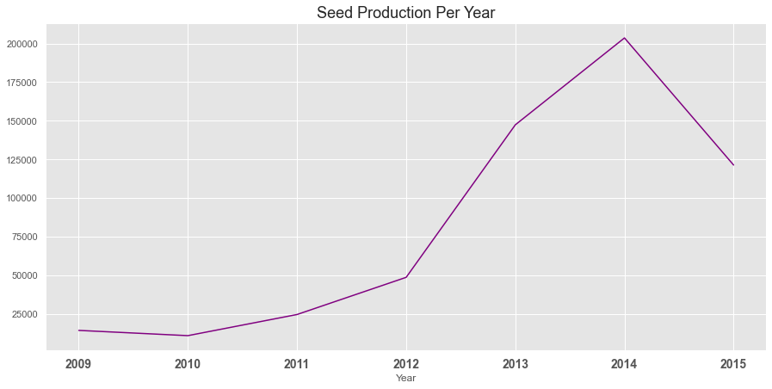
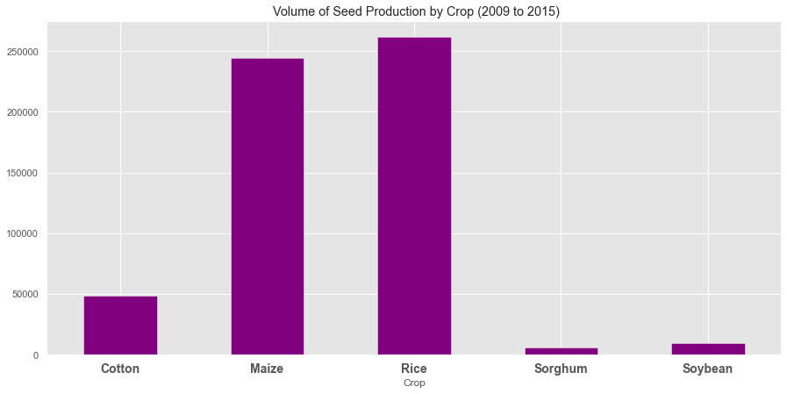
Key Insights and More.
Certified Seed Production data:
* 39k+ observations * 7 categorical features * 3 numeric variables * 1 date attribute - year

Slide 4
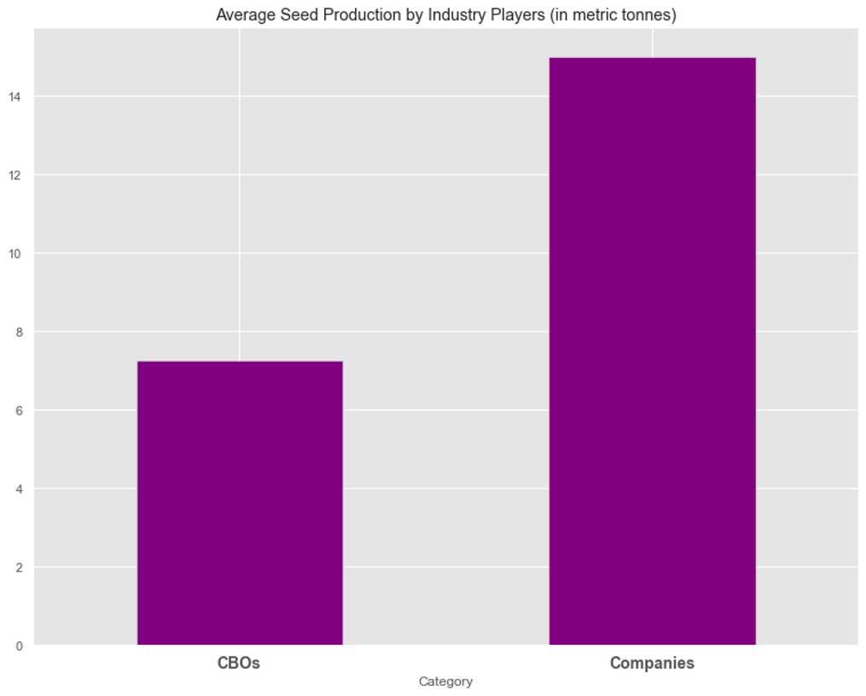
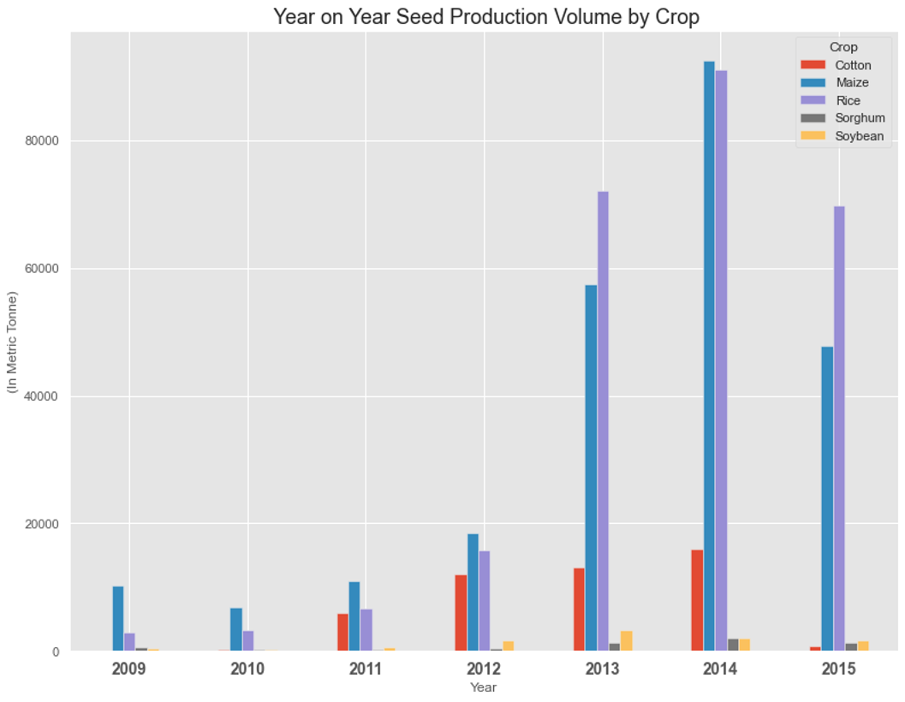
Key Insights and More.

Slide 5
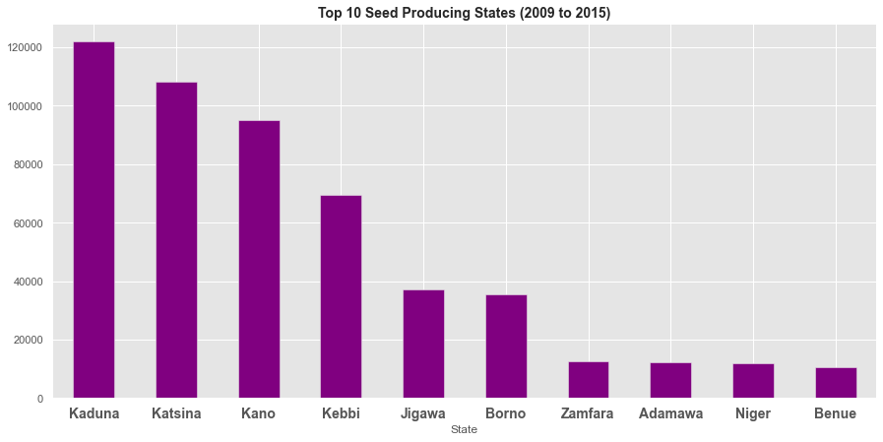
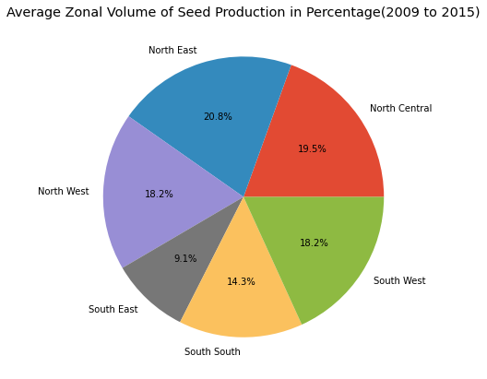
Insights and More.

